Slide 1


UNIVERSITY INSTITUTE OF ENGINEERING
Academic Unit V
Bachelor of Engineering
(Computer Science & Engineering)
Biology For Engineers
23SZT-148
Gene Interaction
DISCOVER . LEARN . EMPOWER

Slide 2
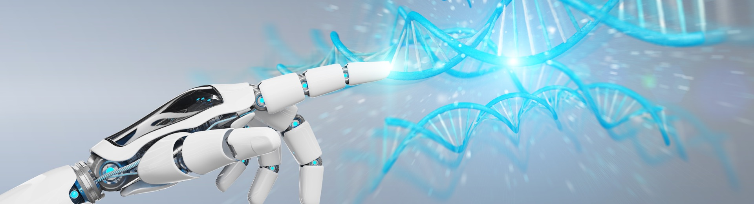
INTRODUCTION
Course Objective
This subject is designed to impart fundamental knowledge on basic of genetics and emerging fields of biology like biomedical recording system and medical instrumentation.
It is designed to impart knowledge that how to apply basics of biology in engineering.
https://www.uic.es/sites/default/files/uic-grau-bioenginyeria-hero-header_1.jpg

Slide 3
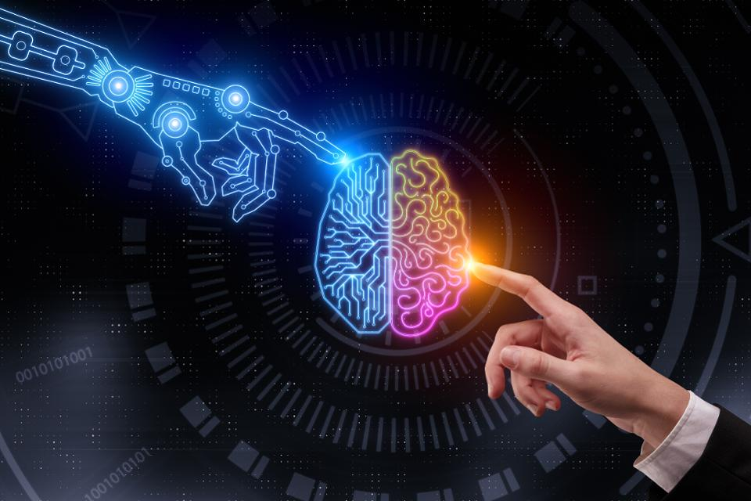
INTRODUCTION
Space for visual (size 24)
Course Outcome
CO Number | Title | Level
CO1 | Identify the biological concepts from an engineering perspective. | Knowledge
CO2 | Development of artificial systems mimicking human action. | Understand
CO3 | Explain the basic of genetics that helps to identify and formulate problems | Analyze
CO4 | Apply knowledge of measurement system, biomedical recording system and biosensors to excel in areas such as entrepreneurship, medicine, government, and education. | Apply
CO5 | Integrate biological principles for developing next generation technologies, | Create
Will be covered in this lecture
https://specials-images.forbesimg.com/imageserve/1034901762/960x0.jpg?fit=scale

Slide 4
SYLLABUS
Unit-1 | Importance of Biology In Engineering | Contact Hours: 15
Chapter 1 Significance of Biology in Engineering Chapter 2 Genetics | Introduction: Fundamental Differences between Science and engineering by drawing a comparison between eye and camera, Bird flying and aircraft. Significance of Biology in Engineering, Discuss how biological observations of 18th Century that lead to major discoveries, Examples from Brownian motion and the origin of thermodynamics by referring to the original observation of Robert and Julius Mayor. Genetics: Mendel’s laws, Concept of segregation and independent assortment, concept of allele, gene mapping, Gene interaction, Epitasis, Meiosis and Mitosis as a part of genetics. Mechanism of how genetic material passes from parent to offspring. Concepts of recessiveness and dominance. Concept of mapping of phenotype to Genes, single gene disorders in humans, concept of complementation using human genetics.

Slide 5
Gene Interaction

Slide 6
Gene Interaction
The term genetic interaction (GI) covers a group of functional relationships between genes.
Most of the characters of living organisms are controlled/influenced by a collaboration of several different genes.
The phenomenon of two or more genes affecting the expression of each other in various ways in the development of a single character of an organism is known as gene/genetic interaction.
Gene interaction produces novel phenotypes.
Functional association between genes

Slide 7
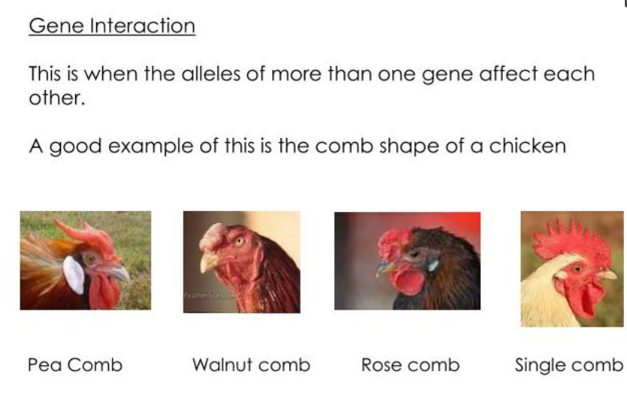
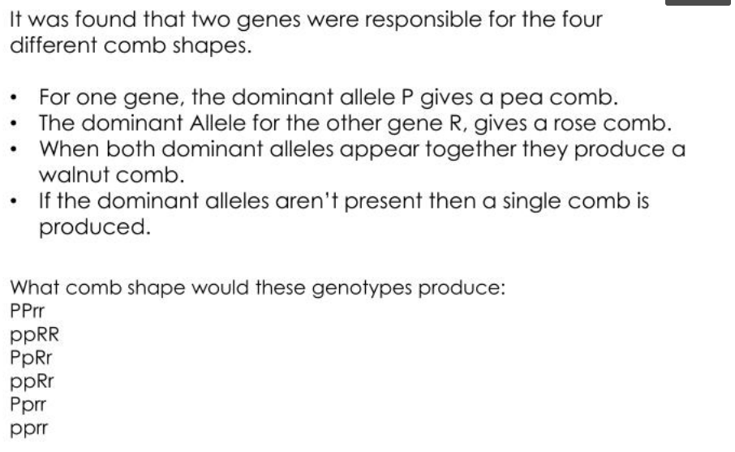
Comb- Outgrowth of chicken head

Slide 8
Types of Gene Interaction
Gene interactions can be classified as:
Allelic gene interaction (non epistatic gene interaction/intra-allelic interaction/Intra-genic interaction):
The alleles of the same gene interact in such a way to produce the new character.
Incomplete dominance
Co-dominance
Non-allelic (Inter-allelic/Inter-genic interaction) gene interaction or epistatic gene interaction
The independent gene located on same or different chromosomes interact with one another for expression of single phenotypic trait.
Epistasis

Slide 9
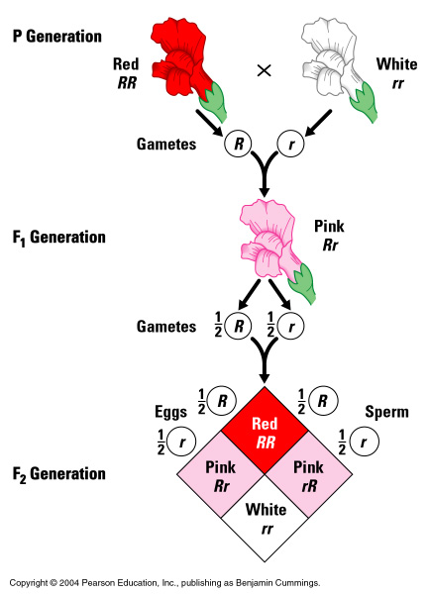
Incomplete Dominance Allelic gene interaction
Antirrhinum majus
Incomplete dominance is a partial expression of alleles in heterozygous condition
Hybrid show a intermediate phenotype instead of one of the parents
In F2 generation genotypic ratio is 1:2:1 but phenotypic ratio is also 1:2:1
Reproductive cells

Slide 10
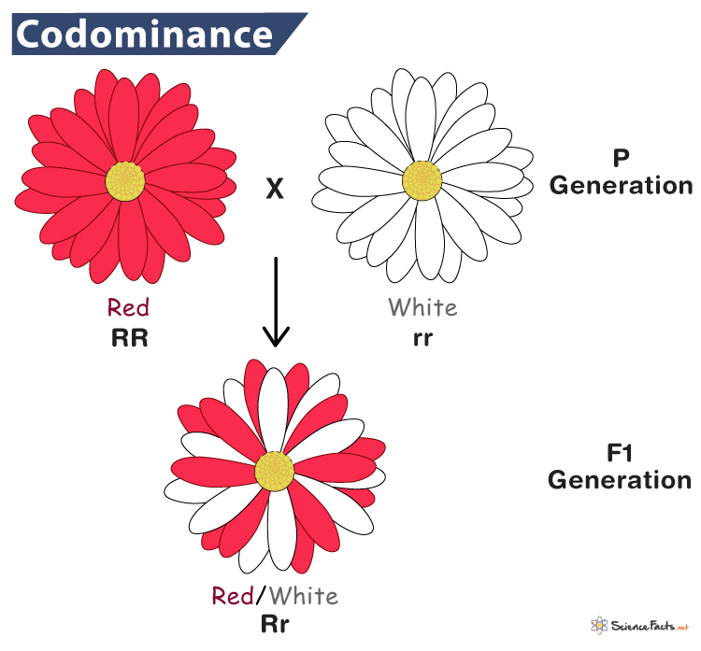
Co dominance Allelic gene interaction
Co – Together- Both allele dominant
Co-dominance is the type of dominance where the offspring show similarity to both the parents and it is due to the blending of alleles

Slide 11
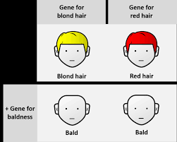
Epistasis Non- Allelic gene interaction
Phenomenon of masking or suppressing the expression of gene by another non-allelic gene.
In epistasis, one gene’s alleles mask the effects of another gene’s alleles to result either in the suppression of the effect or they both combine to produce a new trait (character).
A gene or locus which suppressed or masked the action of a gene at another locus was termed suppressor or epistatic gene.
The gene or locus which was suppressed by an epistatic gene was called hypostatic gene.

Slide 12
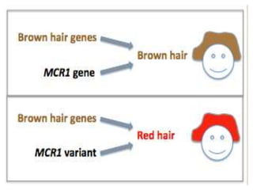
Mobilized colistin resistance" (mcr-1) gene
The MC1R gene provides instructions for making a protein called the melanocortin 1 receptor.
Melanin is the substance that gives skin, hair, and eyes their color.

Slide 13
REFERENCES
Gupta, P.K.. Cytology, Genetics and Molecular Biology, Rastogi Publishers, Meerut, 1993.
Roit I.M., Brostoff J. and Male D. Mosby .Immunology (6 th Edition) by, An imprint of Elsevier Sci Ltd., 2002.
https://nptel.ac.in/courses/121/106/121106008/
https://www.utoledo.edu/engineering/bioengineering/undergrad/prospective/whatisbioe.html#:~:text=Bioengineering%20is%20the%20application%20of,health%20care%20and%20other%20fields.
https://i.pinimg.com/originals/68/c9/30/68c930e95113ceb2e3dfc9de2f164680.png
https://youtu.be/FBUpnG1G4yQ

Slide 14
THANK YOU

